Slide 1

SUBMITTED BY :
SHILPA RANJAN
(00313507313)
RENU
(00513507313)

Slide 2

The use of robots in industrial production has grown significantly in the past decades worldwide.
In contrast the use of robots in other applications is still limited.
Service robots which are partially or fully automated perform tasks for people instead of serving industrial manufacturer.
Book picking robot is a service robot which perform tasks such as book finding , picking and delivering it to the reader.
The process of book finding and picking is automated by this work. The robot developed move towards the book .

Slide 3

ROBOT
It is reprogrammable , multifunction manipulator designed to move material , parts tools or specialized device through various programmed motions for the performance of variety of tasks.
ROBOTICS
It is a branch of technology that deals with the design, construction, operation and application of robots as well as computer system for their control , sensory feedback and information processing.

Slide 4

A library is a collection of information resources; it provide invaluable service to its members, to a wider community.
Typically we need a librarian to pick the book and handover it to the person to whom the books are being issued.
Also, to search for the books by humans take a lot of time as many a times the books gets overlooked the human eye.
To overcome this problem we introduce automation in library to fast diction of books and for picking we suggest a robot with an arm with some degrees of freedom which will be able to find out the book with the required tag and then pick it and place it on the table.
These system is very essential and useful to reduce human Effort and save time.

Slide 5

Microcontroller (At 89S52)
RFID reader( EM18)
RFID card
Power Supply (7805 REGULATOR)
Motor and Motor driver IC(L293D)
LCD
TWS 434
RWS 434

Slide 6
HT-12D (decoder)
HT-12E (encoder)
Diode
crystal

Slide 7

Integrated chip that typically contains integrated CPU, memory (RAM ROM), I/O ports on a single Chip.
System on a single Chip.
Designed to execute a specific task to control a single System.
Microcontrollers often operate at very low speed compared to microprocessors (at clock speeds of as little as 32 kHz), but this is useful for typical applications. They also consume very little power (milliwatts or even micro watts).
Microcontrollers are used in automatic products and devices.
In addition to the usual arithmetic and logic elements of a general microprocessor, the microcontroller also has additional elements such as RAM for data storage, read-only memory for program storage, flash memory for permanent data storage, and other devices (peripherals).

Slide 8

Low-power, high-performance CMOS 8-bit microcontroller.
89c51 have RISC architecture and contains less no of opcodes which are easy for programming.
In 40 pin AT89C51, there are four ports designated as P₁, P₂, P₃ and P₀.
All these ports are 8-bit bi-directional ports, i.e., they can be used as both input and output ports.
Except P₀ which needs external pull-ups, rest of the ports have internal pull-ups.
Flash (Kbytes):4 Kbytes
Pin Count:40
Max. Operating Freq. (MHz):24 MHz
Max I/O Pins:32
SRAM (Kbytes):0.125
Operating Voltage (Vcc):4.0 to 5.5
Timers:2

Slide 9
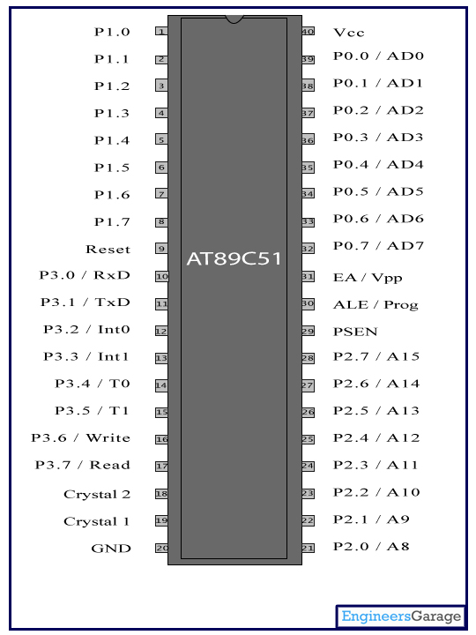

Slide 10

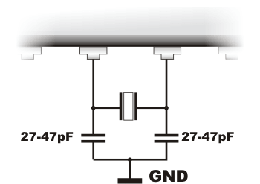
Pin no 18 and 19 is connected to external crystal oscillator to provide a clock to the circuit.
Crystals provide the synchronization of the internal function and to the peripherals.
Whenever we are using crystals we need to put the capacitor behind it to make it free from noises.
It is good to go for a 33pf capacitor.
The speed with which a microcontroller executes instructions is determined by what is known as the crystal speed.

Slide 11

Radio-frequency identification (RFID) is the wireless use of electromagnetic fields to transfer data, for the purposes of automatically identifying and tracking tags attached to objects.
RFID READER
An RFID reader's function is to interrogate RFID tags.
The means of interrogation is wireless and because the distance is relatively short; line of sight between the reader and tags is not necessary.
A reader contains an RF module, which acts as both a transmitter and receiver of radio frequency signals.
The transmitter consists of an oscillator to create the carrier frequency; a modulator to impinge data commands upon this carrier signal and an amplifier to boost the signal enough to awaken the tag.
The receiver has a demodulator to extract the returned data and also contains an amplifier to strengthen the signal for processing.

Slide 12

These are small transponders (combined radio receiver and transmitter) that will transmit identity information over a short distance, when asked.
Some tags can be read from several meters away and beyond the line of sight of the reader.
The tag stored in non- volatile memory.
Most RFID tags contain at least two parts:
One is an integrated circuit for storing and processing information, modulating and de-modulating a radio-frequency (RF) signal, and other specialized functions.
The second is an antenna for receiving and transmitting the signal.
There are generally two types of RFID tags:
active RFID tags, which contain a battery.
passive RFID tags, which have no battery.

Slide 13

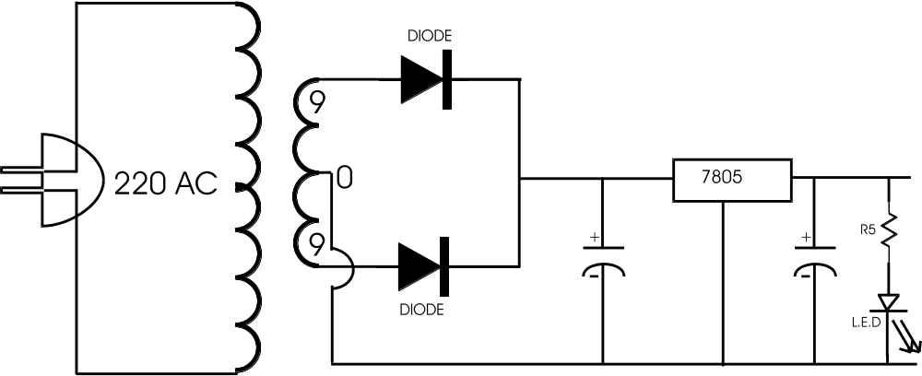

Slide 14
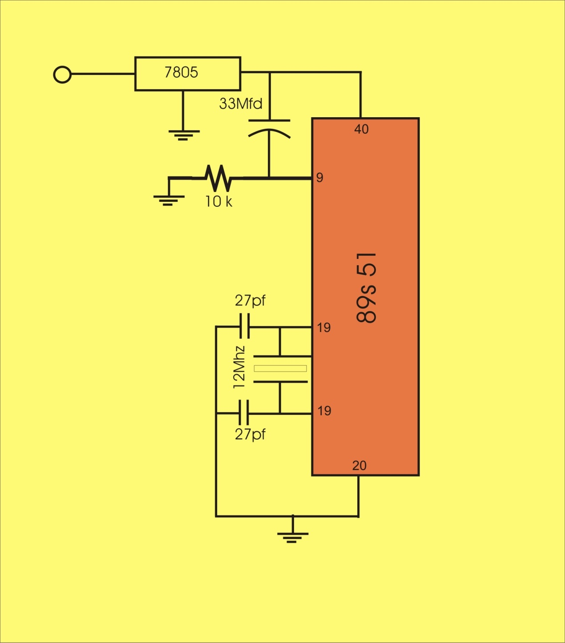

Slide 15

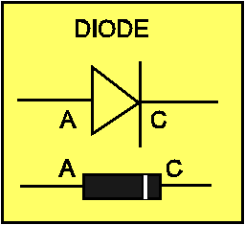
In this project we use IN 4007 diode as a rectifier.
IN 4007 is special diode to convert the AC into DC.
In this project we use two diodeas a rectifier. Here we use full wave rectifier. Output of rectifier is pulsating DC.
To convert the pulsating dc into smooth dc we use Electrolytic capacitor as a main filter.
Capacitor converts the pulsating dc into smooth dc and this DC is connected to the Regulator circuit for Regulated 5 volt DC.

Slide 16

L293D is a typical Motor driver or Motor Driver IC which allows DC motor to drive on either direction.
L293D is a 16-pin IC which can control a set of two DC motors simultaneously in any direction.
It works on the concept of H-bridge.
H-bridge is a circuit which allows the voltage to be flown in either direction
Due its size it is very much used in robotic application for controlling DC motors.
Pin 1 and 9 are Enable pins.

Slide 17

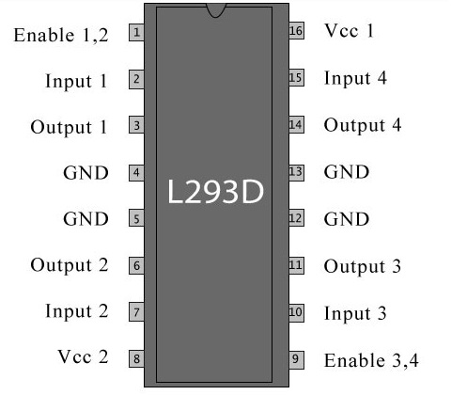

Slide 18

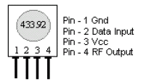
The TWS-434 transmitter accepts both linear and digital inputs, can operate from 1.5 to 12 Volts-DC.

Slide 19
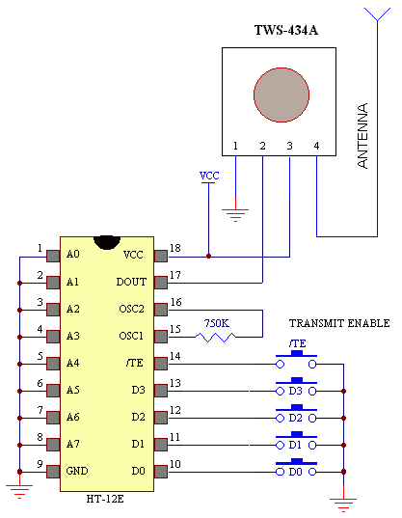

Slide 20

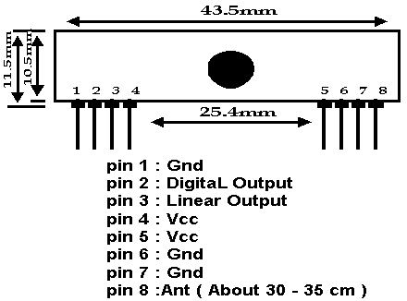
These wireless receivers work with our 434MHz transmitters.
They can easily fit into a breadboard and work well with microcontrollers to create a very simple wireless data link.
Since these are only receivers, they will only work communicating data one-way.
Features:
434 MHz
500ft range
4800bps data rate
5V supply voltage

Slide 21
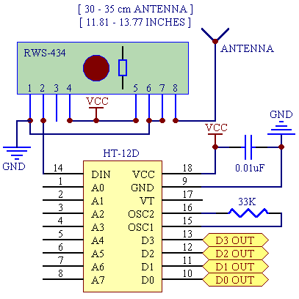

Slide 22

HT12D is a decoder integrated circuit .
It decodes the serial addresses and data received by, say, an RF receiver, into parallel data and sends them to output data pins.
The serial input data is compared with the local addresses three times continuously.
The input data code is decoded when no error or unmatched codes are found.
HT12D is capable of decoding 12 bits, of which 8 are address bits and 4 are data bits. The data on 4 bit latch type output pins remain unchanged until new is received.

Slide 23
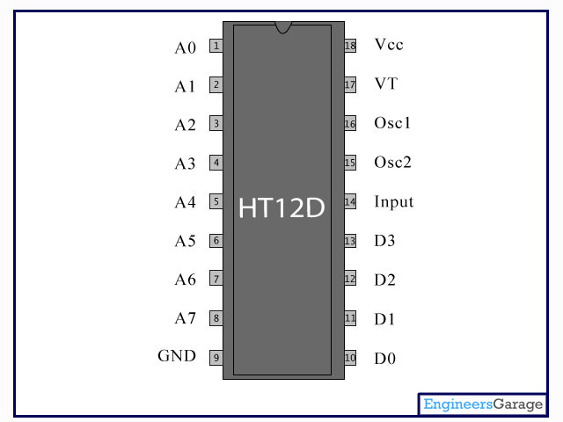

Slide 24

HT12E is an encoder integrated circuit. It is mainly used in interfacing RF and infrared circuits.
Simply put, HT12E converts the parallel inputs into serial output. It encodes the 12 bit parallel data into serial for transmission through an RF transmitter.
HT12E has a transmission enable pin which is active low. When a trigger signal is received on TE pin, the programmed addresses/data are transmitted together with the header bits via an RF or an infrared transmission medium.
HT12E begins a 4-word transmission cycle upon receipt of a transmission enable. This cycle is repeated as long as TE is kept low.
As soon as TE returns to high, the encoder output completes its final cycle and then stops.

Slide 25
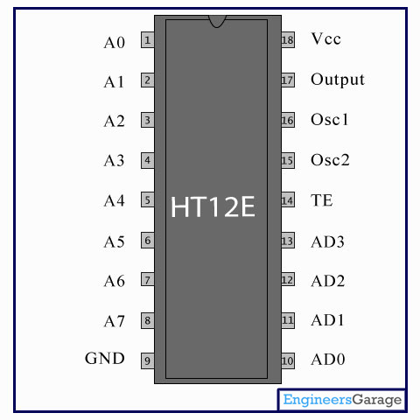

Slide 26

In this project we use 2 by 16 lcd. It means 2 lines and 16 character on one line.
Frequently, an AT89S52 program must interact with the outside world using input and output devices that communicate directly with a human being.
One of the most common devices attached to an 8051 is an LCD display.
Some of the most common LCDs connected to the 8051 are 16x2 and 20x2 displays. This means 16 characters per line by 2 lines and 20 characters per line by 2 lines, respectively.

Slide 27
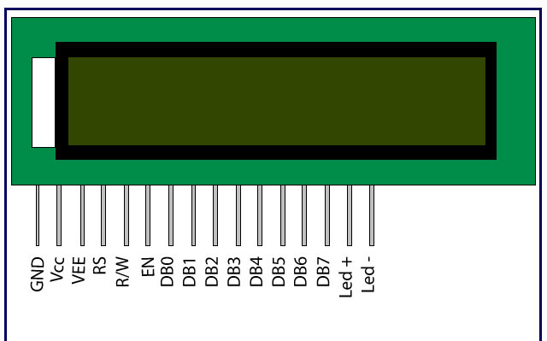

Slide 28
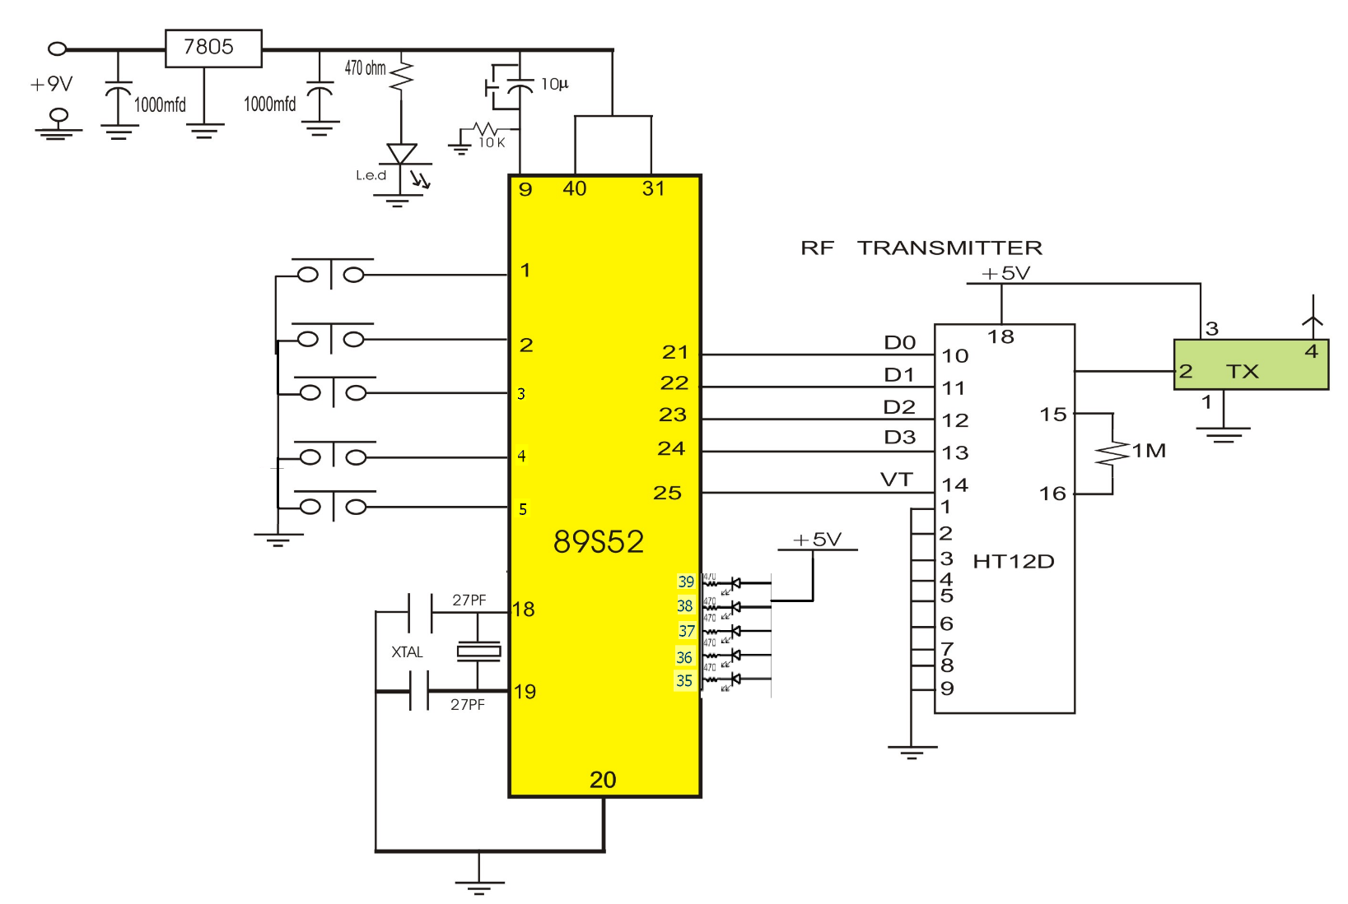

Slide 29
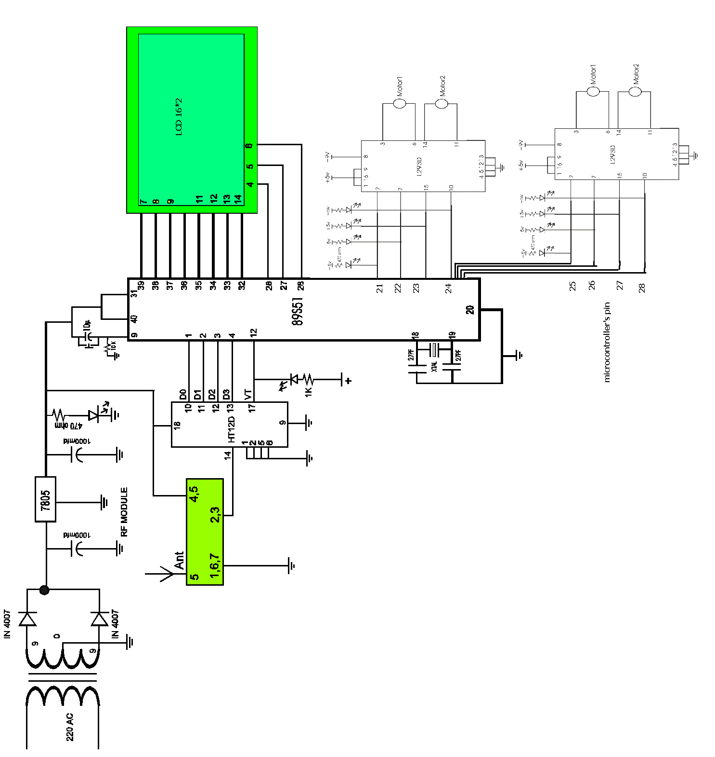

Slide 30

First of all connect the transmitter circuit with battery and the receiver circuit with 230v AC supply using adapter.
Now enter the book number 1, 2 or 3 with the help of switch which is on the receiver circuitry.
After entering the book number now you need to move the robot to the appropriate position that is in front of the shelf.
This is done by using the keys left , right, backward and forward switches mounted on the transmitter PCB.
Now, the “AUTOMATIC BOOK PICK ROBOT” will start sensing the shelf by sensing each book one by one. There is an EM reader used which will sense that which card is attached to the book which has been given the user .

Slide 31
If the card number which is entered is sensed by the robot is obtained then LCD will display that card detected , which is followed by the message book found.
If there is no card available with the number entered then LCD will display the message that no card detected., followed by the message book not found.
There after the robot will grab the book for some time and then I can be moved in whichever direction needed , depending upon the requirement of the user.

Slide 32

The “AUTOMATIC BOOK PICK ROBOT “ is not fully automatic because there is a need of user’s intervention to move the robot in left , right, back and forward direction.
There are some variations in the mechanical part as the movement of robot need to be appropriate without any delay.
The system is slow

Slide 33

To pick the specific book this was the first objective of our project on which we are working.
This project implements the concepts of embedded system, robotics and RFID communication.
The idea of library automation can be achieved with the help of this project.

